Slide 1
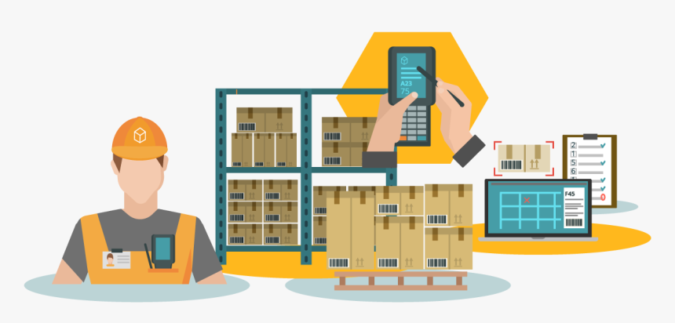
INVENTORY MANAGEMENT SYSTEM
GROUP :- 6

Slide 2
Team members
Employee Id | Name
2498607 | BOLLINI SaiManojKumar
2498175 | S Ruhina Afreen
2498170 | Dagara Hari Prasad
2498808 | Mahalingappa Gari KALPANA
2498900 | Murukooti Srinivasula Reddy
2499255 | Yogesh Dhananjay Parekar
2498522 | Mohammed Musthaq S
2496112 | Kanneboyina Sreeram(TEAM LEAD)
2496402 | KONDURU PREETHAM
2495957 | SHAIK SUBHANI

Slide 3

Frontend Team Backend Team
Dagara Hari Prasad
BOLLINI SaiManojKumar
S Ruhina Afreen
Mohammed Musthaq
Kanneboyina Sreeram
Yogesh Dhananjay Parekar
Shaik Subhani
Konduru Preetham
Murukooti SrinivasulaReddy
MahalingappaGari KALPANA

Slide 4
ABSTRACTION
Inventory Management System is important to ensure quality control in businesses that handle transactions revolving around consumer goods. Without proper inventory control, a large retail store may run out of stock on an important item. A good Inventory Management System will alert the retailer when it is time to reorder. Inventory Management System is also an important means of automatically tracking large shipments

Slide 5
INTRODUCTION
A business can run smoothly its operating activities only when appropriate amount of inventory is maintained. Inventory affects all operating activities like manufacturing, warehousing, sales etc. The amount of opening inventory and closing inventory should be sufficient enough so that the other business activities are not adversely affected. Thus, inventory plays an important role in operations management.

Slide 6
TECHNOLOGY USED
HTML : Page layout has been designed in HTML
CSS : CSS has been used for all the designing part
JavaScript : All the validation task and animations has been developed by JavaScript
JSP : All the front end logic has been written in JSP
Java : All the business logic has been written in Java
MySQL : MySQL database has been used as database for the project
Angular CLI : Command-line interface tool that we use to initialize.

Slide 7
ENVIRONMENTS
The system will be developed on any Windows OS machine using J2EE, Hibernate and Spring.
Intel hardware machine (PC P4-2.26 GHz, 512 MB RAM, 40 GB HDD)
Server – Apache Tomcat 8
Database – My SQL
My SQL J Connector
Node Version 10
Angular CLI
JDK 1.8
Eclipse IDE or Spring Tool Suite

Slide 8
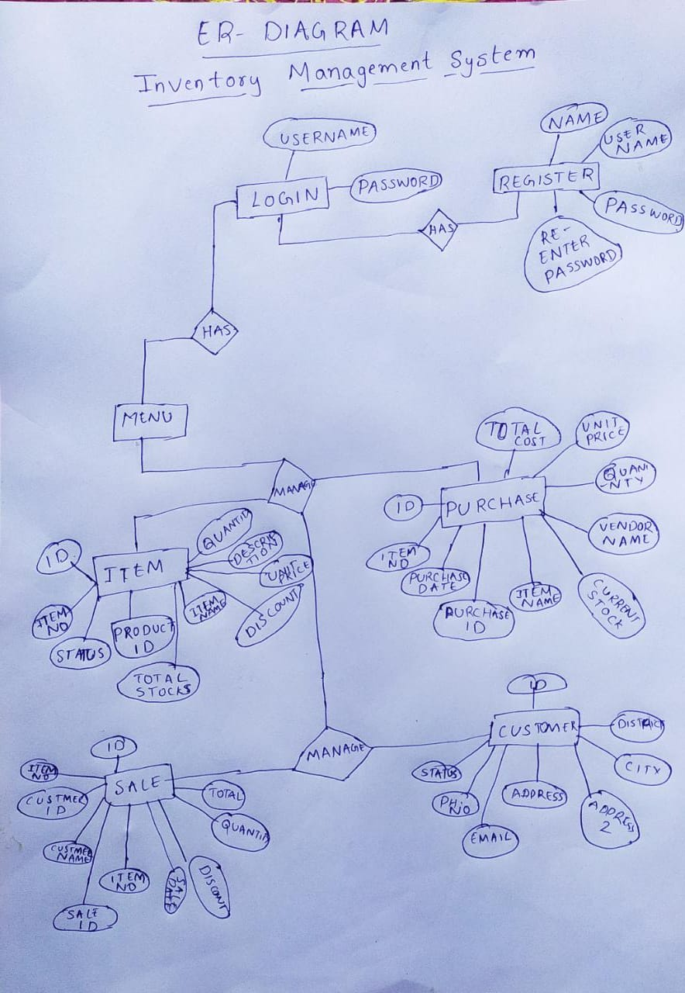
ER-DAIGRAM

Slide 9
Why Is Inventory Management Important?
Inventory management Plays important role to a company’s health because it helps make sure there is rarely too much or too little stock on hand, limiting the risk of stock outs and inaccurate records.

Slide 10
Benefits of Inventory Management
Saves Money:
Improves Cash Flow:
Satisfies Customers:
Increased Sales
Improved Delivery Performance

Slide 11
INVENTORY
Inventory is a complete list of items such as property, goods in stock.
It is also used for a list of the contents of a household.
Inventory or stock refers to the goods and materials that a business holds for the ultimate goal of resale, production or utilization.

Slide 12
INVENTORY MANAGEMENT
inventory management is the function of understanding the stock mix of a company and the different demands on that stock.
Inventory management helps companies identify which and how much stock to order at what time. It tracks inventory from purchase to the sale of goods.
Inventory management is important for every other business enterprise.

Slide 13
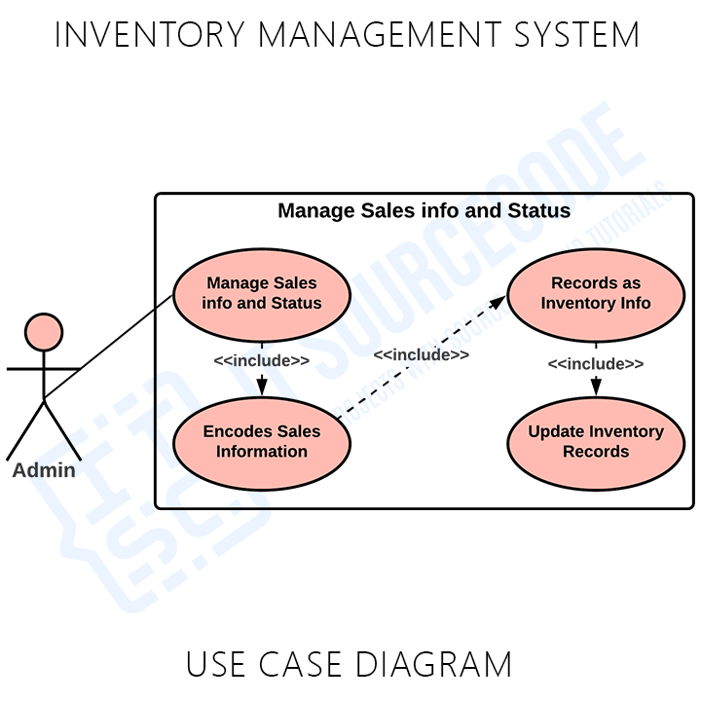
PROJECT FLOW

Slide 14
Modules
1.User Registration
2.User Login
3.Item Management
4.Purchases Management
5.Sales Management
6.Customer Management

Slide 15
USER MODULE
Register to the application.
Sign in to the application to maintain the record of activities.
Search for item by giving item number and item name.
Check the total stock of the item, Check the sale details.
Fill the customer details by giving name, phone number and address.

Slide 16
REGISTER MODULE
FIELD REQUIRED :
Name:
Username:
Password:
REST API’S :
login:
register:
reset password:
clear:

Slide 17
LOGIN MODULE
FIELD REQUIRED :
Username:
password:
REST API’S :
add:
update:
delete:
clear:

Slide 18
ITEM MODULE
FIELD REQUIRED :
item number:
product id:
item name:
description:
discount%:
quantity:
unit price:
total stock:
REST API’S :
add:
update:
delete:
clear:

Slide 19
PURCHASE MODULE
FIELD REQUIRED :
item number:
item name:
purchase date:
purchase id:
current stock:
vendor name:
quantity:
unit price:
total cost:
REST API’S :
Add:
update:
clear:

Slide 20
SALE MODULE
FIELD REQUIRED :
item number:
item name:
customer name:
customer id:
sale id:
sale date:
total stock:
discount%:
quantity:
unit price:
total:
REST API’S :
Add:
update:
clear:

Slide 21
CUSTOMER MODULE
FIELD REQUIRED :
name:
customer id:
phone(mobile):
phone 2:
email:
address:
city:
district:
REST API’S PERFORMED :
Add:
update:
delete:
clear:

Slide 22
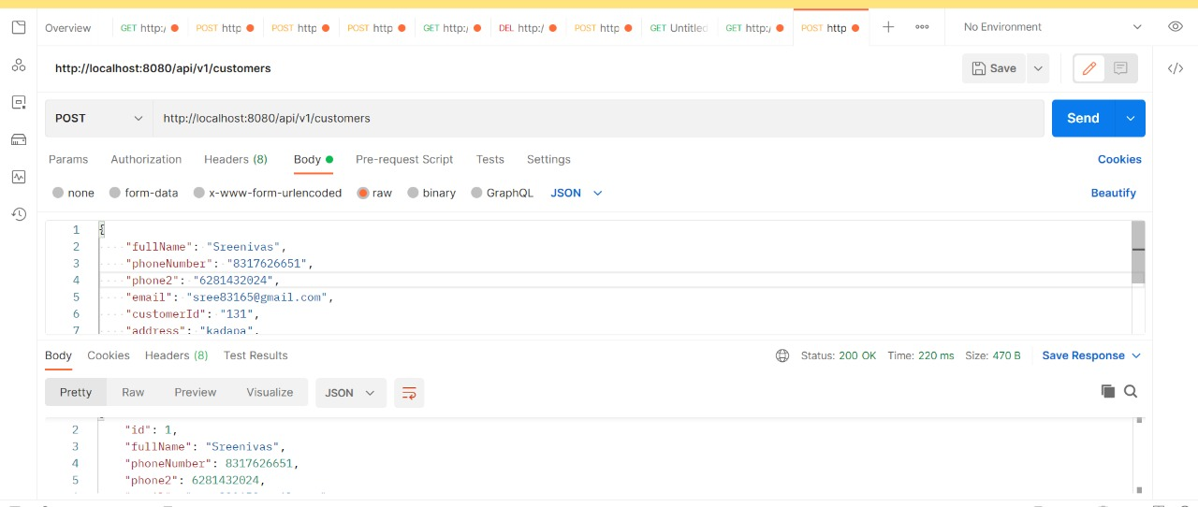
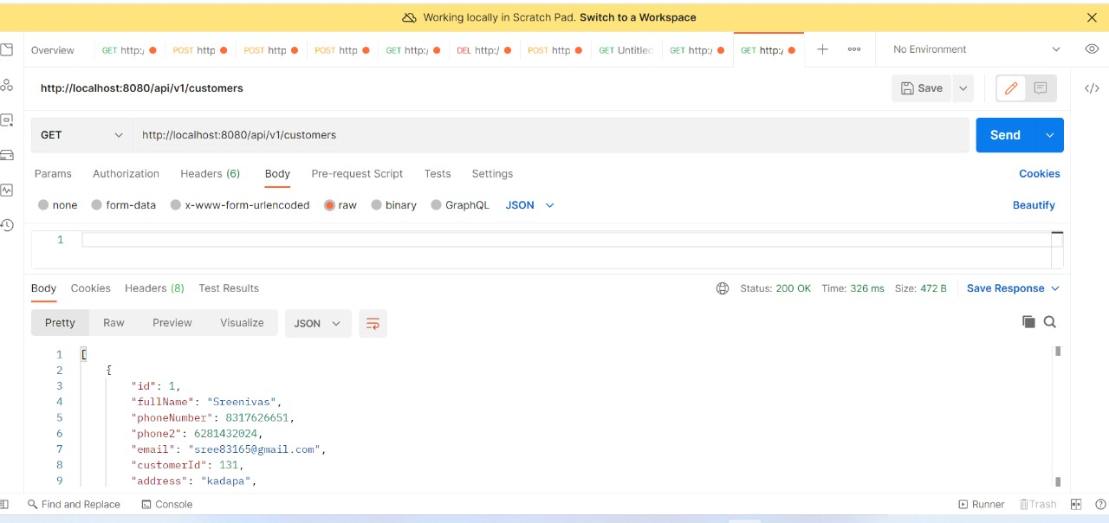
POST MAN SCREENSHOTS CREATE CUSTMERS REST API RETRIEVE ALL CUSTOMERS API

Slide 23
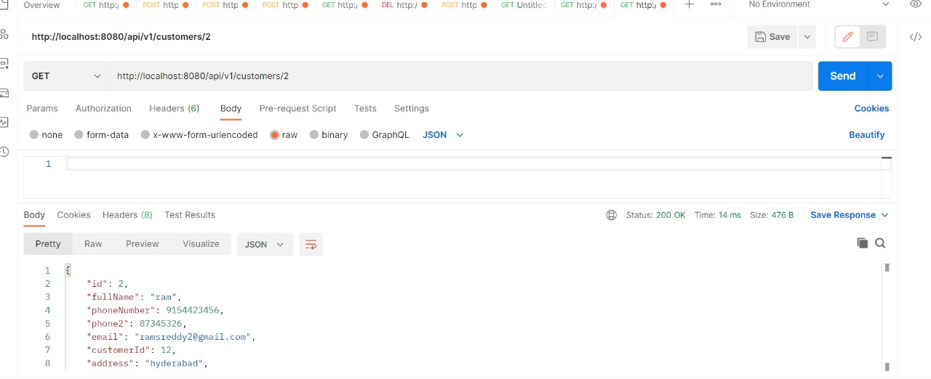
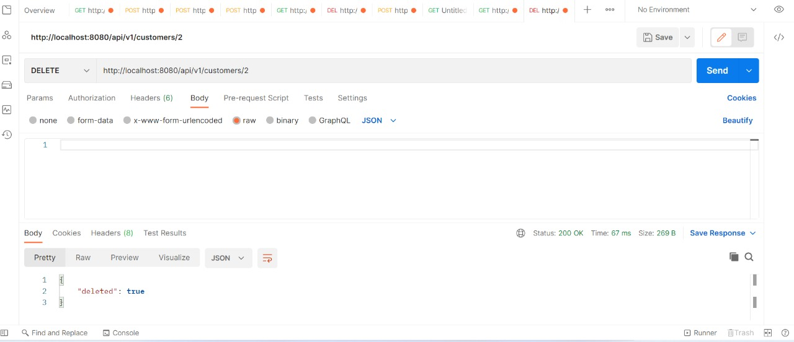
GET CUSTOMER BY ID (REST AP) DELETE CUSTOMER BY ID(REST API)

Slide 24
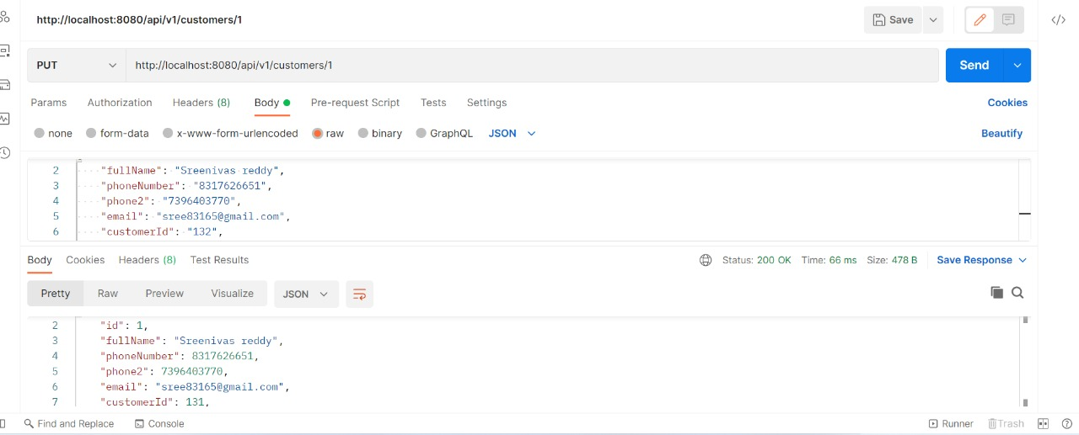
UPDATE CUSTOMER BY ID

Slide 25
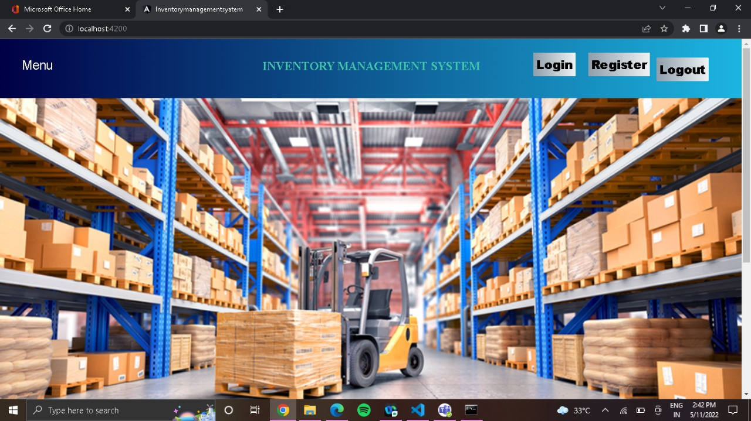
OUTPUT SCREENSHOTS

Slide 26
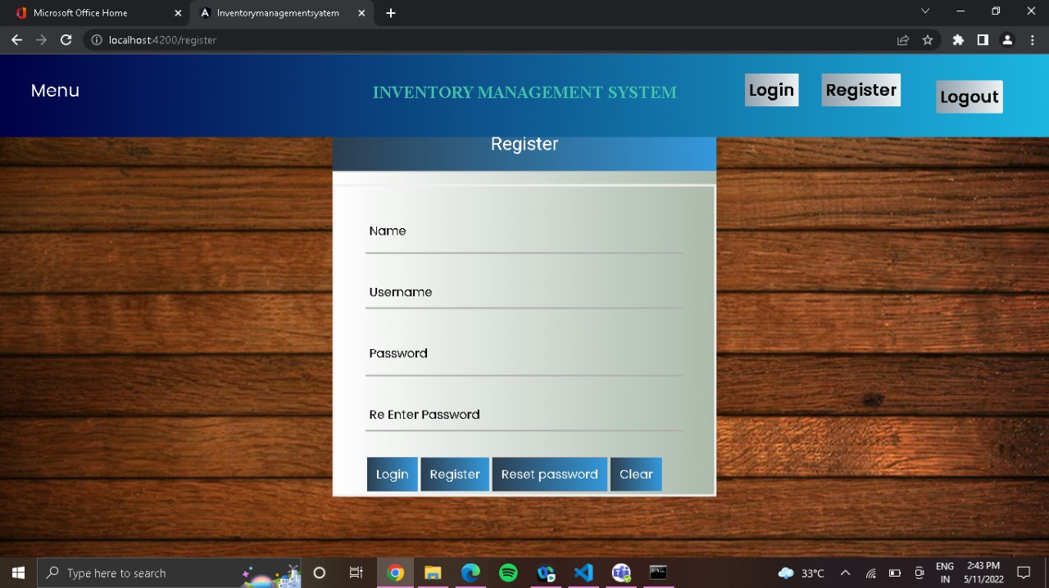

Slide 27
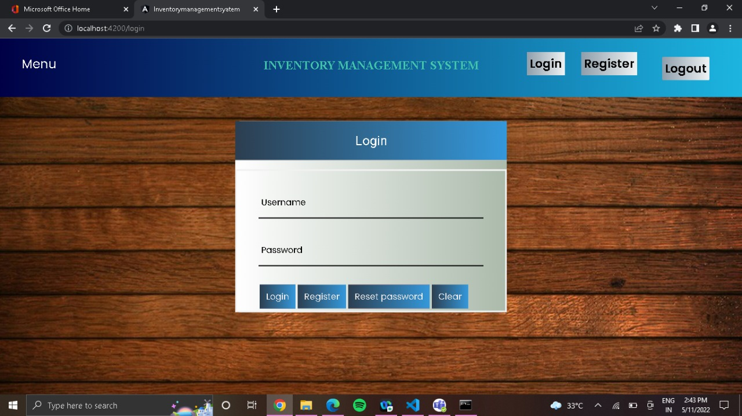

Slide 28
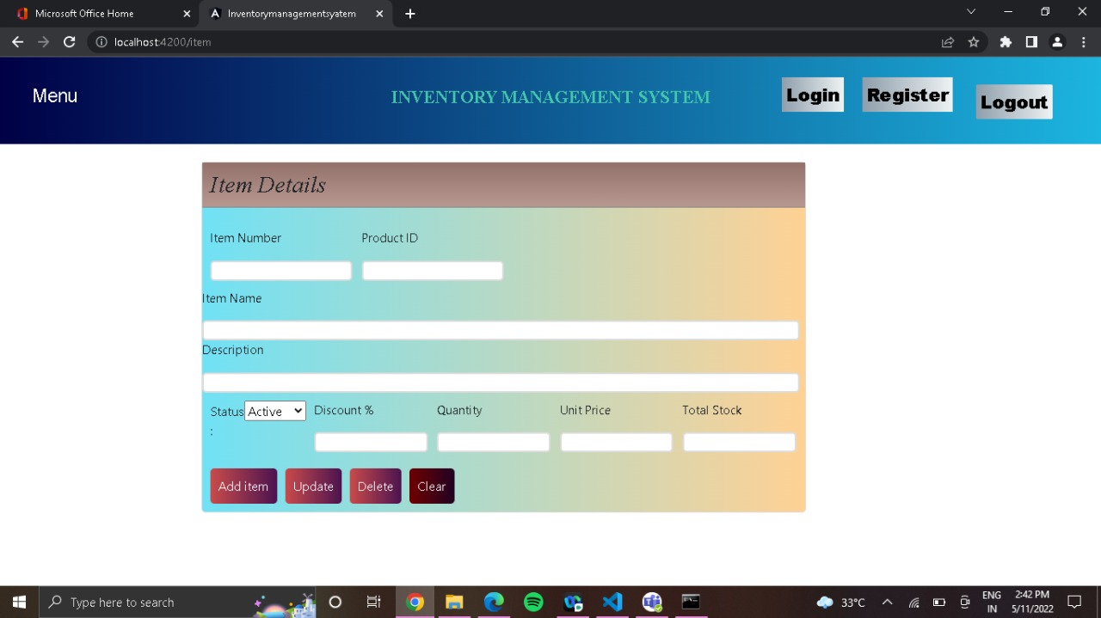

Slide 29
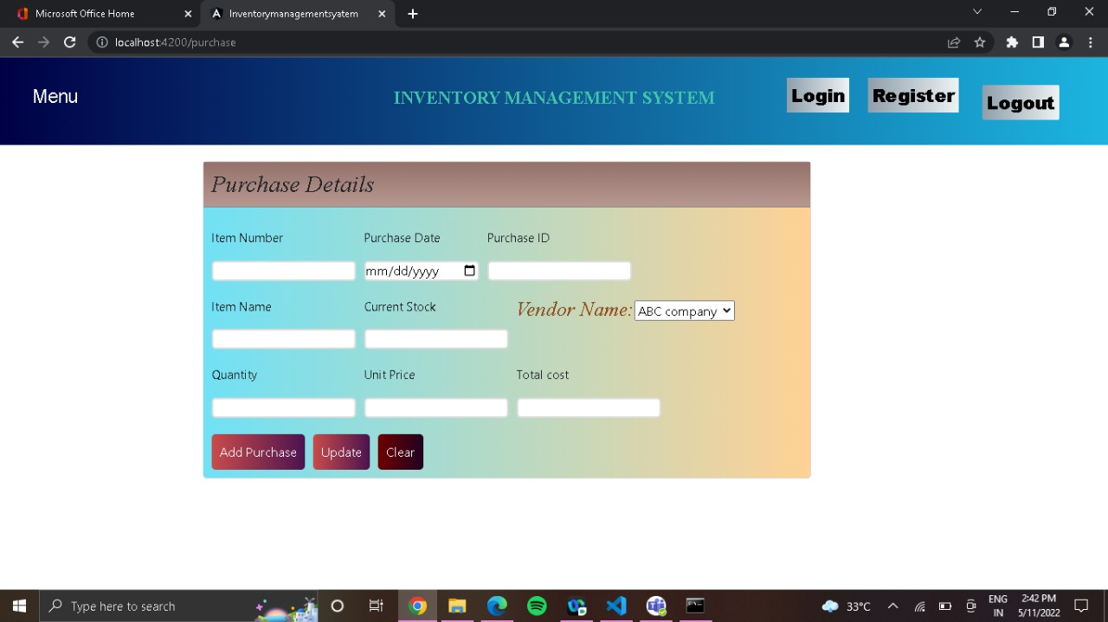

Slide 30
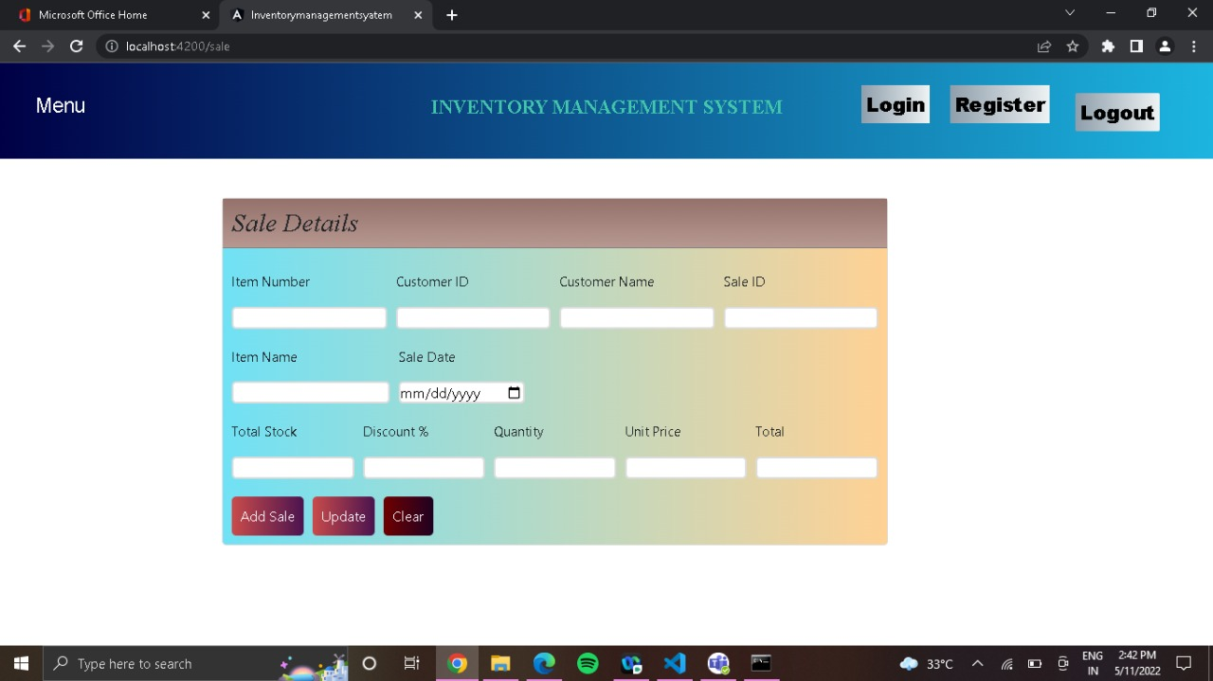

Slide 31
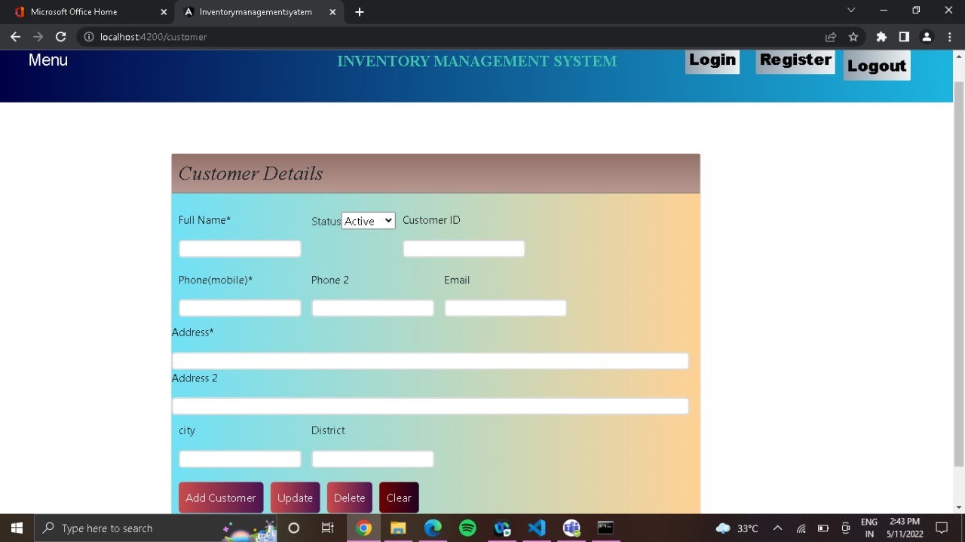

Slide 32
ADVANTAGES
It Reduces Risk of Overselling.
Avoiding Stockouts and Excess Stock.
A More Organized Warehouse.
Better Customer Experience

Slide 33
DISADVANTAGES
Production problem
Increased space is need to hold the inventory
Complexity
High implementation costs

Slide 34
FUTURE IMPLEMENTATION
We can add some more features in future.
We can take feedbacks from the Customers to improve the Customer relationship.
Successful companies will view inventory as a strategic asset, rather than an aggravating expense or an evil to be tolerated.

Slide 35
CONCLUSION
Inventory management is important for keeping costs down, while meeting regulations.
Supply and demand is a delicate balance, and inventory management hopes to ensure that the balance undistributed.

Slide 36


